Slide 1

Windows 9
Cody Lanier
David Dalisay
Jack Tam Huang
John-Paul Le

Slide 2

Why revamp the Front End?
Applicants fill out two separate forms when applying for a MySQL database account and a Project account.
Non ECS account holders may apply for a MySQL database account and a Project account.

Slide 3

Front End Requirements
Merge MySQL database request and Project account request into one.
Validate user ECS email.
Username Validation.
Validation of all data
Send email to an admin

Slide 4
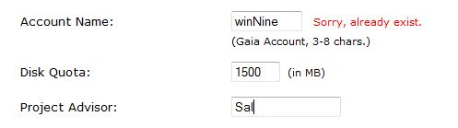
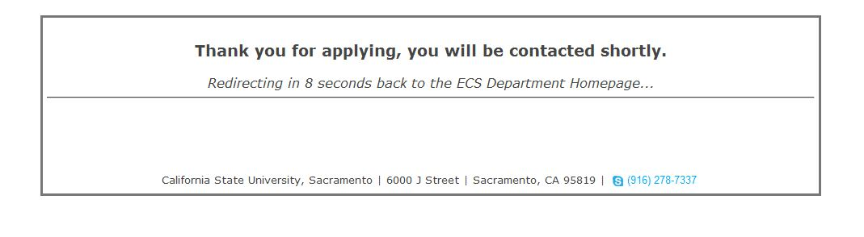
Front End Design
Dynamic Validation
Redirection

Slide 5
Back End Requirement
Sync the Account information on the Server and the Database(Application).
Process "Expired" Accounts.
Process "Active" Accounts.
Process "Pending" Accounts.

Slide 6
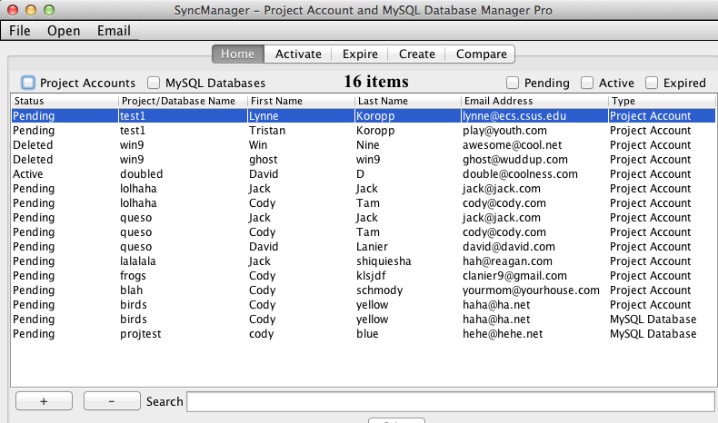
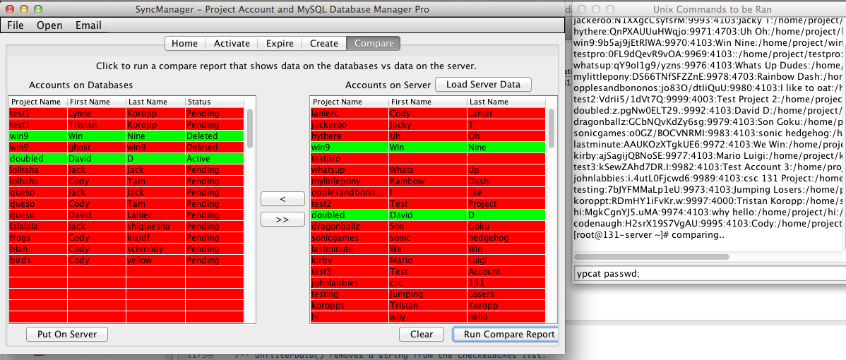
Back End Design
Compares and Sync
Display Outstanding Accounts

Slide 7
Lesson Learned
Communication with the client and the team is essential.
Measure progress to meet deadlines.
Predict the outcome of our work.
Adapt to changes

